Slide 1
BDGL Sieve
“New directions in nearest neighbor searching with applications to lattice sieving”
Anja Becker, Leo Ducas, Nicolas Gama, Thijs Laarhoven 2016
Presented by Ray Perlner

Slide 2
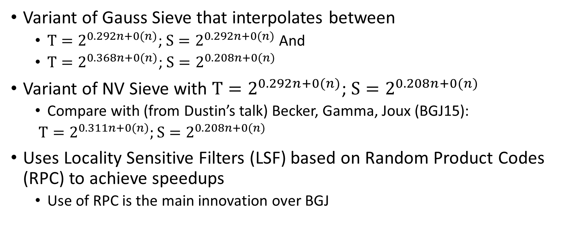
Highlights
Variant of Gauss Sieve that interpolates between
  $T=2^{0.292n+0(n)}$; $S=2^{0.292n+0(n)}$ And
  $T=2^{0.368n+0(n)}$; $S=2^{0.208n+0(n)}$
Variant of NV Sieve with $T=2^{0.292n+0(n)}$; $S=2^{0.208n+0(n)}$
  Compare with (from Dustin’s talk) Becker, Gamma, Joux (BGJ15):
  $T=2^{0.311n+0(n)};S=2^{0.208n+0(n)}$
Uses Locality Sensitive Filters (LSF) based on Random Product Codes (RPC) to achieve speedups
  Use of RPC is the main innovation over BGJ

Slide 3
BGDL in context

Slide 4
Outline
Sieving basics/review
Locality Sensitive Hashing
Locality Sensitive Filtering
Random Product Codes
Gaussian Sieve vs NV Sieve
The chart

Slide 5
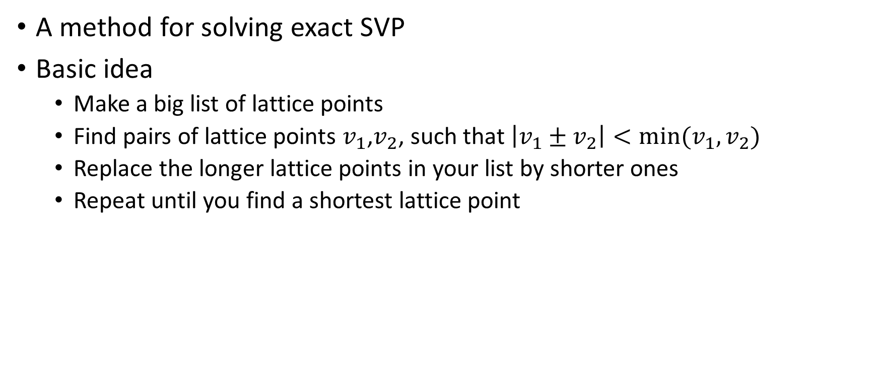
Sieving Review
A method for solving exact SVP
Basic idea
  Make a big list of lattice points
  Find pairs of lattice points $v_{1}$,$v_{2}$, such that $\left|v_{1}±v_{2}\right|<min⁡(v_{1},v_{2})$
  Replace the longer lattice points in your list by shorter ones
  Repeat until you find a shortest lattice point

Slide 6
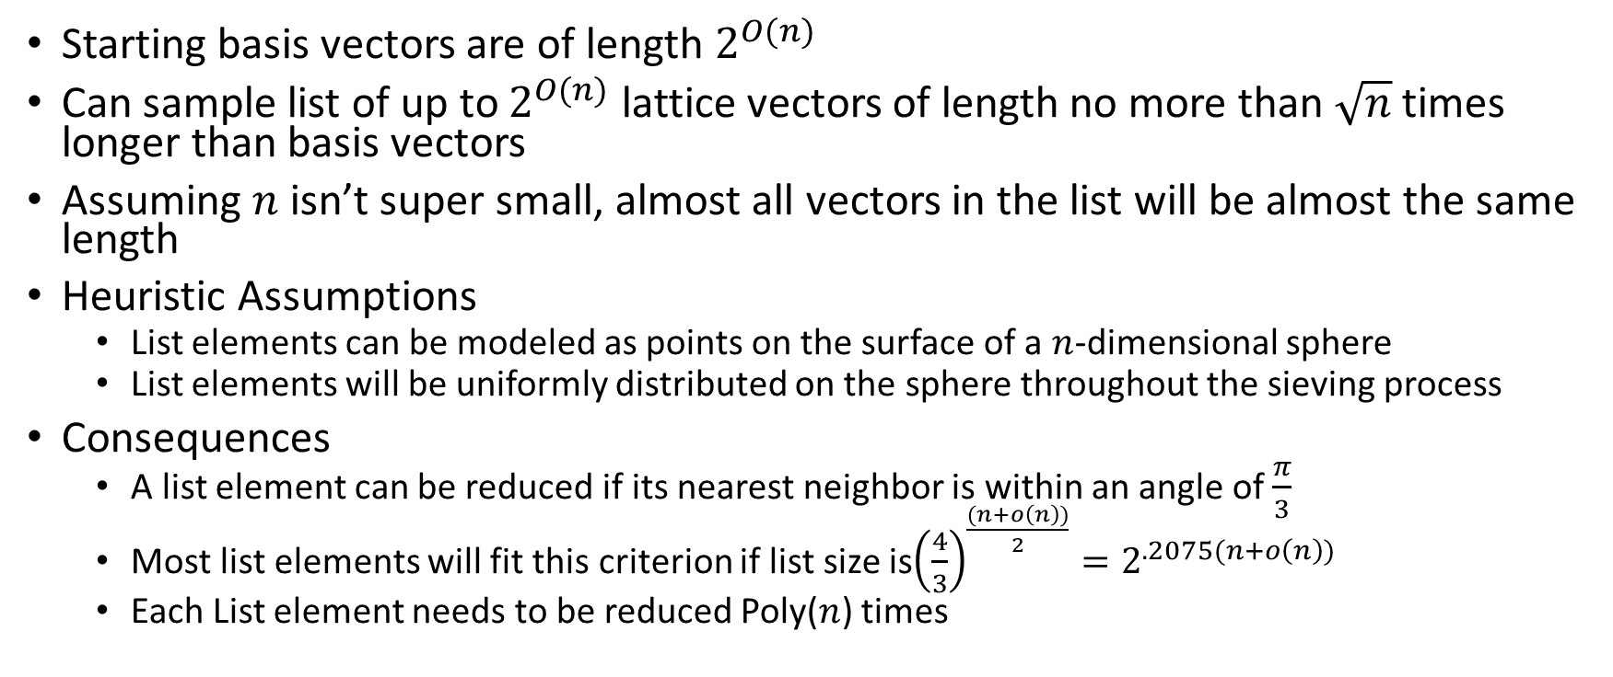
Assumptions for Heuristic Sieving
Starting basis vectors are of length $2^{O(n)}$
Can sample list of up to $2^{O(n)}$ lattice vectors of length no more than $\sqrt{n}$ times longer than basis vectors
Assuming $n$ isn’t super small, almost all vectors in the list will be almost the same length
Heuristic Assumptions
  List elements can be modeled as points on the surface of a $n$-dimensional sphere
  List elements will be uniformly distributed on the sphere throughout the sieving process
Consequences
  A list element can be reduced if its nearest neighbor is within an angle of $\frac{π}{3}$
  Most list elements will fit this criterion if list size is${\left(\frac{4}{3}\right)}^{\frac{(n+o\left(n\right))}{2}}=2^{.2075(n+o\left(n\right))}$
  Each List element needs to be reduced Poly($n$) times

Slide 7

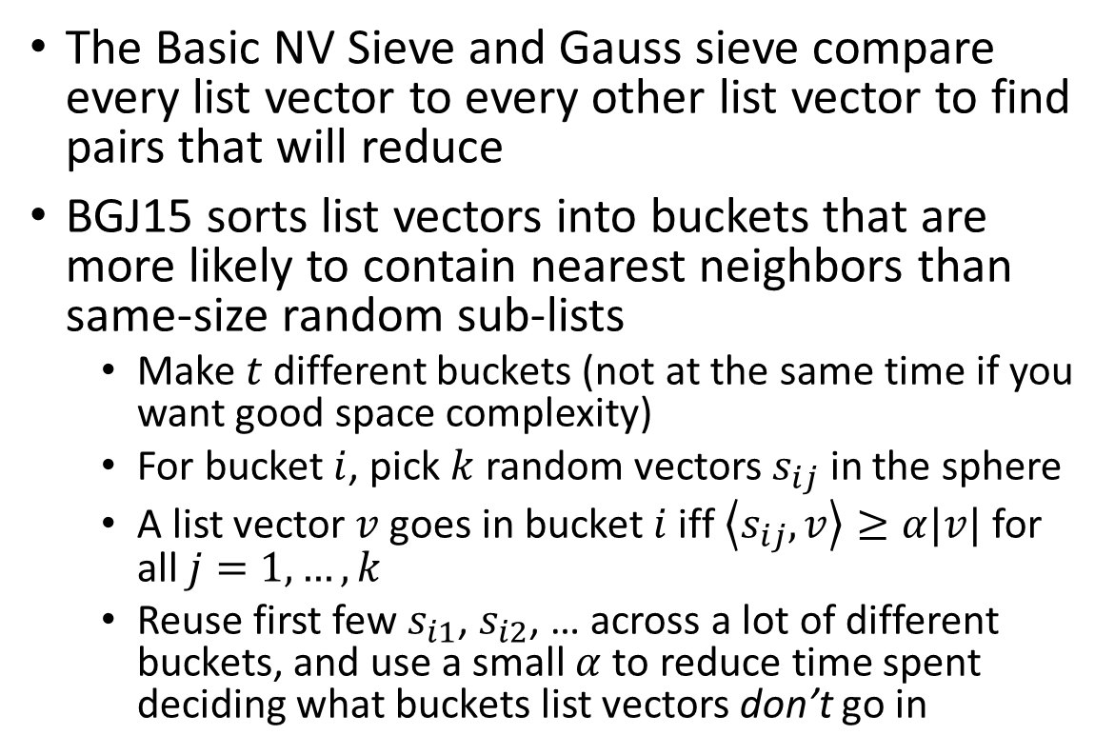



Locality Sensitive Hash
The Basic NV Sieve and Gauss sieve compare every list vector to every other list vector to find pairs that will reduce
BGJ15 sorts list vectors into buckets that are more likely to contain nearest neighbors than same-size random sub-lists
  Make $t$ different buckets (not at the same time if you want good space complexity)
  For bucket $i$, pick $k$ random vectors $s_{ij}$ in the sphere
  A list vector $v$ goes in bucket $i$ iff $\left\langle s_{ij},v\right\rangle ≥α|v|$ for all $j=1, …, k$
  Reuse first few $s_{i1}$, $s_{i2}$, … across a lot of different buckets, and use a small $α$ to reduce time spent deciding what buckets list vectors don’t go in
$v$ passes
$$s_{ij}$$
$v$ fails
$$α$$

Slide 8
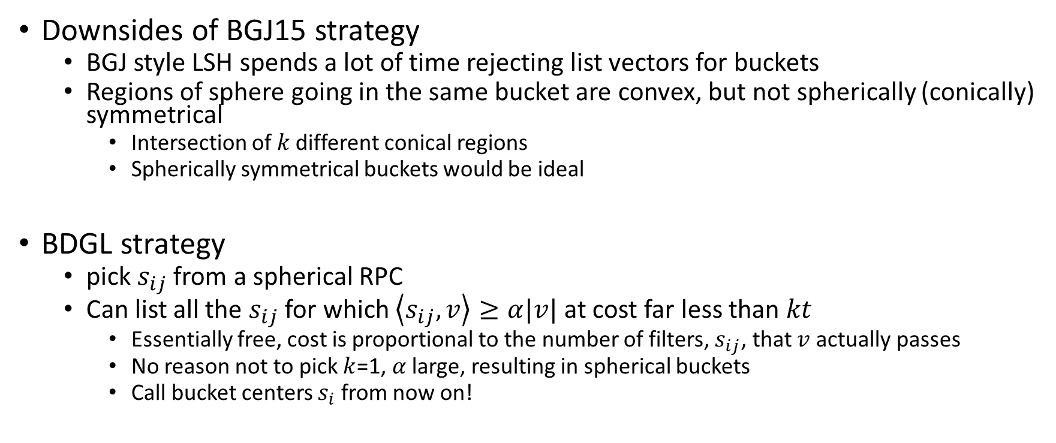
Locally Sensitive Filters with RPC
Downsides of BGJ15 strategy
  BGJ style LSH spends a lot of time rejecting list vectors for buckets
  Regions of sphere going in the same bucket are convex, but not spherically (conically) symmetrical
    Intersection of $k$ different conical regions
    Spherically symmetrical buckets would be ideal
BDGL strategy
  pick $s_{ij}$ from a spherical RPC
  Can list all the $s_{ij}$ for which $\left\langle s_{ij},v\right\rangle ≥α|v|$ at cost far less than $kt$
    Essentially free, cost is proportional to the number of filters, $s_{ij}$, that $v$ actually passes
    No reason not to pick $k$=1, $α$ large, resulting in spherical buckets
    Call bucket centers $s_{i}$ from now on!

Slide 9
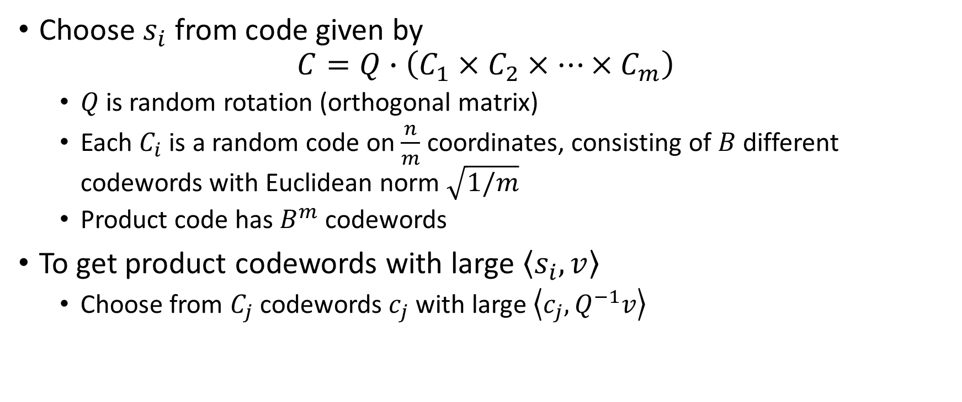
RPC Format
Choose $s_{i}$ from code given by
$$C=Q∙\left(C_{1}×C_{2}×…×C_{m}\right)$$
  $Q$ is random rotation (orthogonal matrix)
  Each $C_{i}$ is a random code on $\frac{n}{m}$ coordinates, consisting of $B$ different codewords with Euclidean norm $\sqrt{1/m}$
  Product code has $B^{m}$ codewords
To get product codewords with large $\left\langle s_{i},v\right\rangle$
  Choose from $C_{j}$ codewords $c_{j}$ with large $\left\langle c_{j},Q^{−1}v\right\rangle$

Slide 10
RPC list decoding algorithm

Slide 11
Gauss Sieve vs NV Sieve
Best asymptotic time-space tradeoff in BDGL is based on modifying NV Sieve
However, BDGL implemented and spent most of their time analyzing a modified version of Gauss Sieve

Slide 12
Gauss Sieve (unmodified, from MV10)

Slide 13
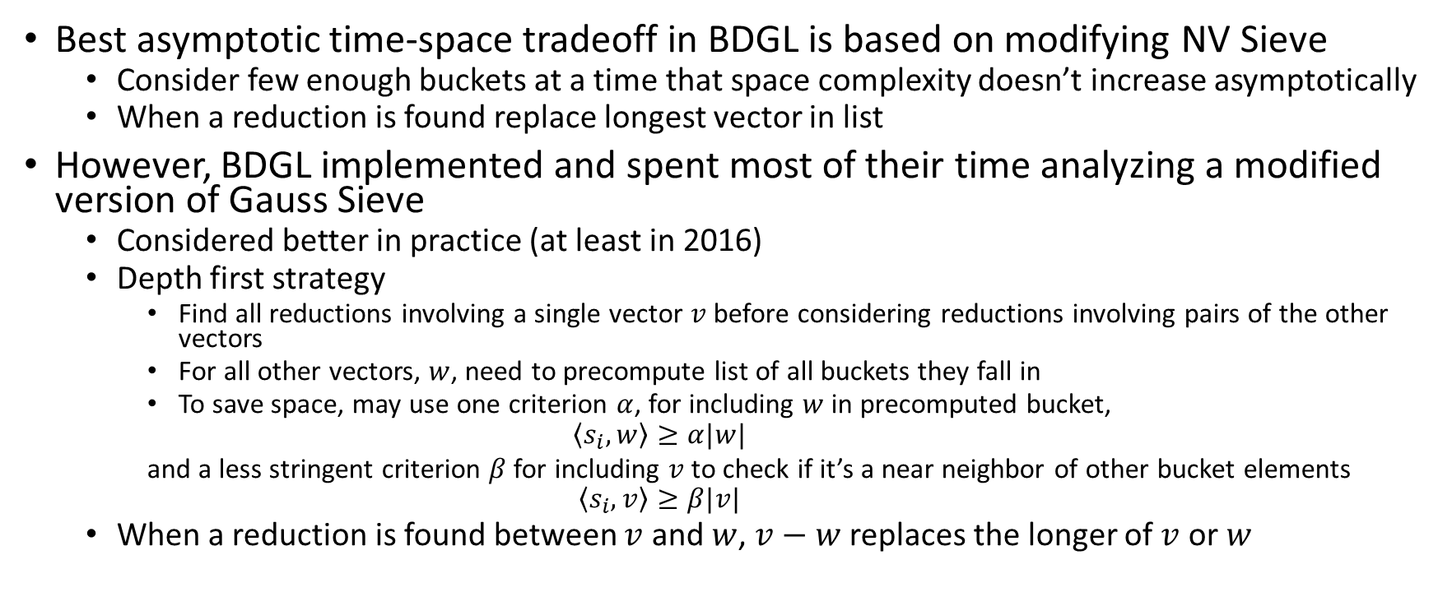
Gauss Sieve vs NV Sieve
Best asymptotic time-space tradeoff in BDGL is based on modifying NV Sieve
  Consider few enough buckets at a time that space complexity doesn’t increase asymptotically
  When a reduction is found replace longest vector in list
However, BDGL implemented and spent most of their time analyzing a modified version of Gauss Sieve
  Considered better in practice (at least in 2016)
  Depth first strategy
    Find all reductions involving a single vector $v$ before considering reductions involving pairs of the other vectors
    For all other vectors, $w$, need to precompute list of all buckets they fall in
    To save space, may use one criterion $α$, for including $w$ in precomputed bucket,
    $$\left\langle s_{i},w\right\rangle ≥α|w|$$
    and a less stringent criterion $β$ for including $v$ to check if it’s a near neighbor of other bucket elements
    $$\left\langle s_{i},v\right\rangle ≥β|v|$$
  When a reduction is found between $v$ and $w$, $v−w$ replaces the longer of $v$ or $w$

Slide 14
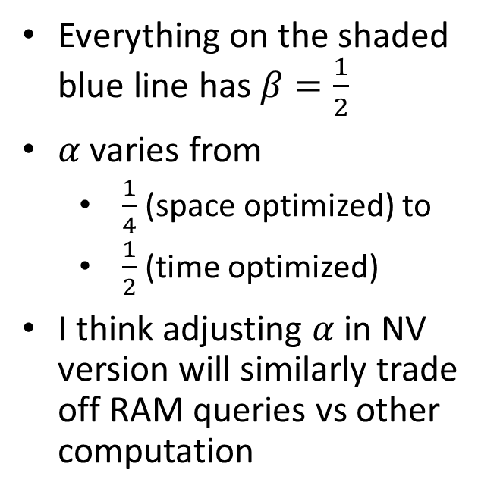
Complexity graph revisited
Everything on the shaded blue line has $β=\frac{1}{2}$
$α$ varies from
  $\frac{1}{4}$ (space optimized) to
  $\frac{1}{2}$ (time optimized)
I think adjusting $α$ in NV version will similarly trade off RAM queries vs other computation

Slide 15
Experimental Results

Slide 16
References
BDGL: https://eprint.iacr.org/2015/1128.pdf
BGJ15: https://eprint.iacr.org/2015/522.pdf
MV10: https://epubs.siam.org/doi/pdf/10.1137/1.9781611973075.119
NV: https://www.degruyter.com/document/doi/10.1515/JMC.2008.009/html

